Slide 1
OLSmodel Engineering and Application
MATLAB Presentation
Chung Shun Man (20-621-587) & Matthias Lukosch (20-601-050)

Slide 2


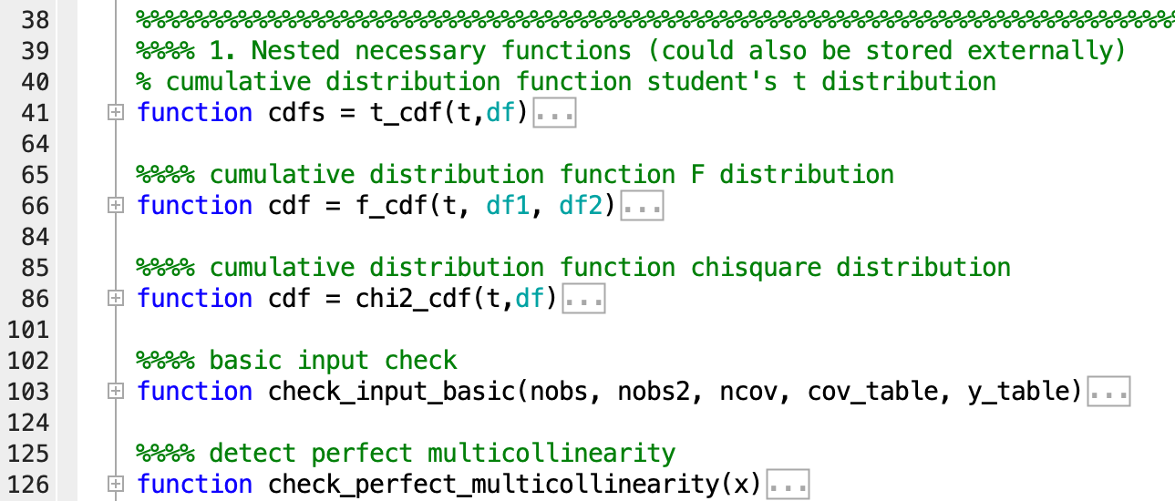
Objectives
Easy and handy to use
Powerful end efficient
Modular
Implementation in MATLAB
Function keeps track of variable names
Matrix notation
Able to conduct diagnostic tests on the validity of OLS assumptions
Nested functions within the parental OLSmodel

Slide 3
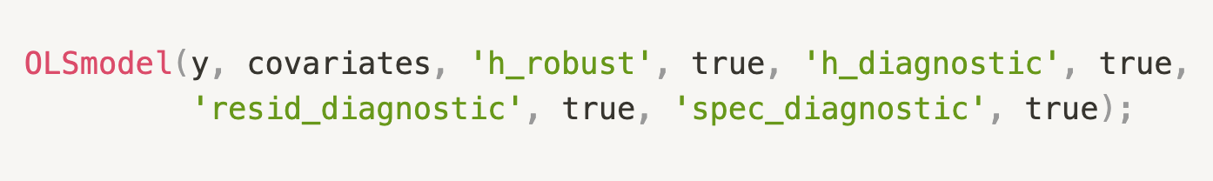

Usage Example

Slide 4



Features
Standard
Additional
OLS coefficients
Predicted outcome values
Hypotheses tests
Measures of fit
Information criteria
Heteroskedasticity robust standard errors
Multicollinearity diagnostic
Heteroskedasticity diagnostic
OLS residuals distribution and autocorrelation diagnostic
Specification diagnostic

Slide 5
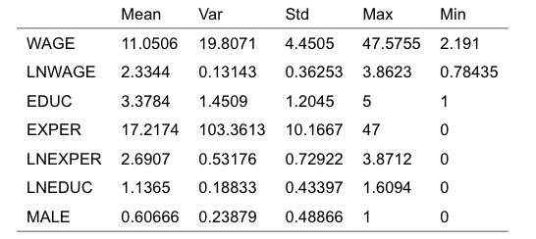
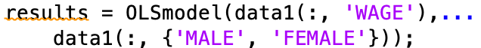
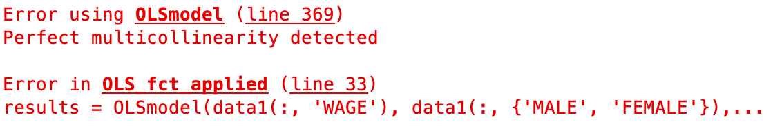
Application: Economic problem and multicollinearity
1. Statistical summary
2. Incorrect specification
Data anomaly

Slide 6
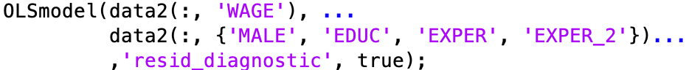
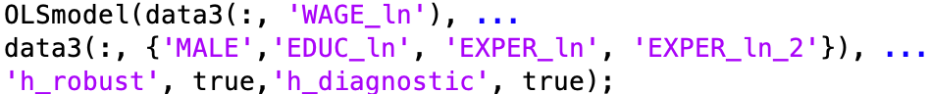
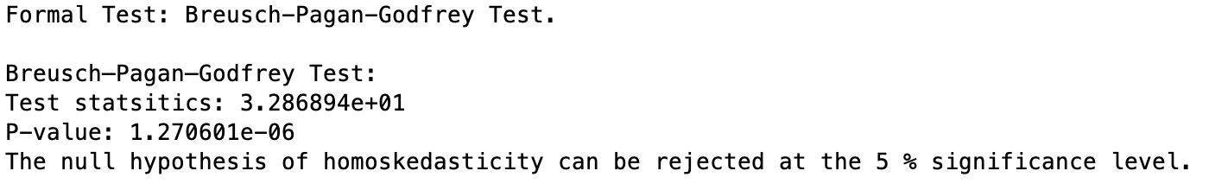
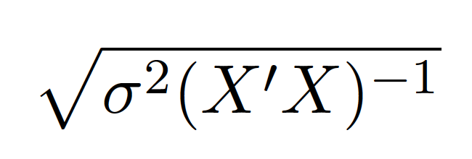
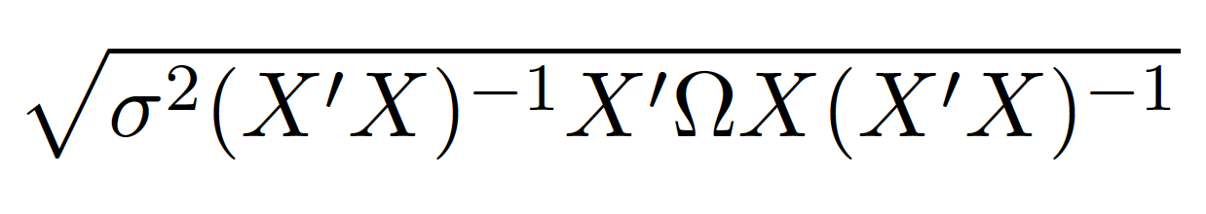
Regression 2
Model visualization
Model Diagnostics and Remedy

Slide 7
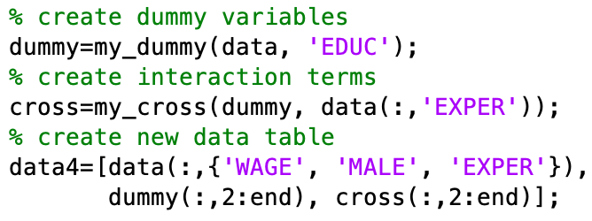
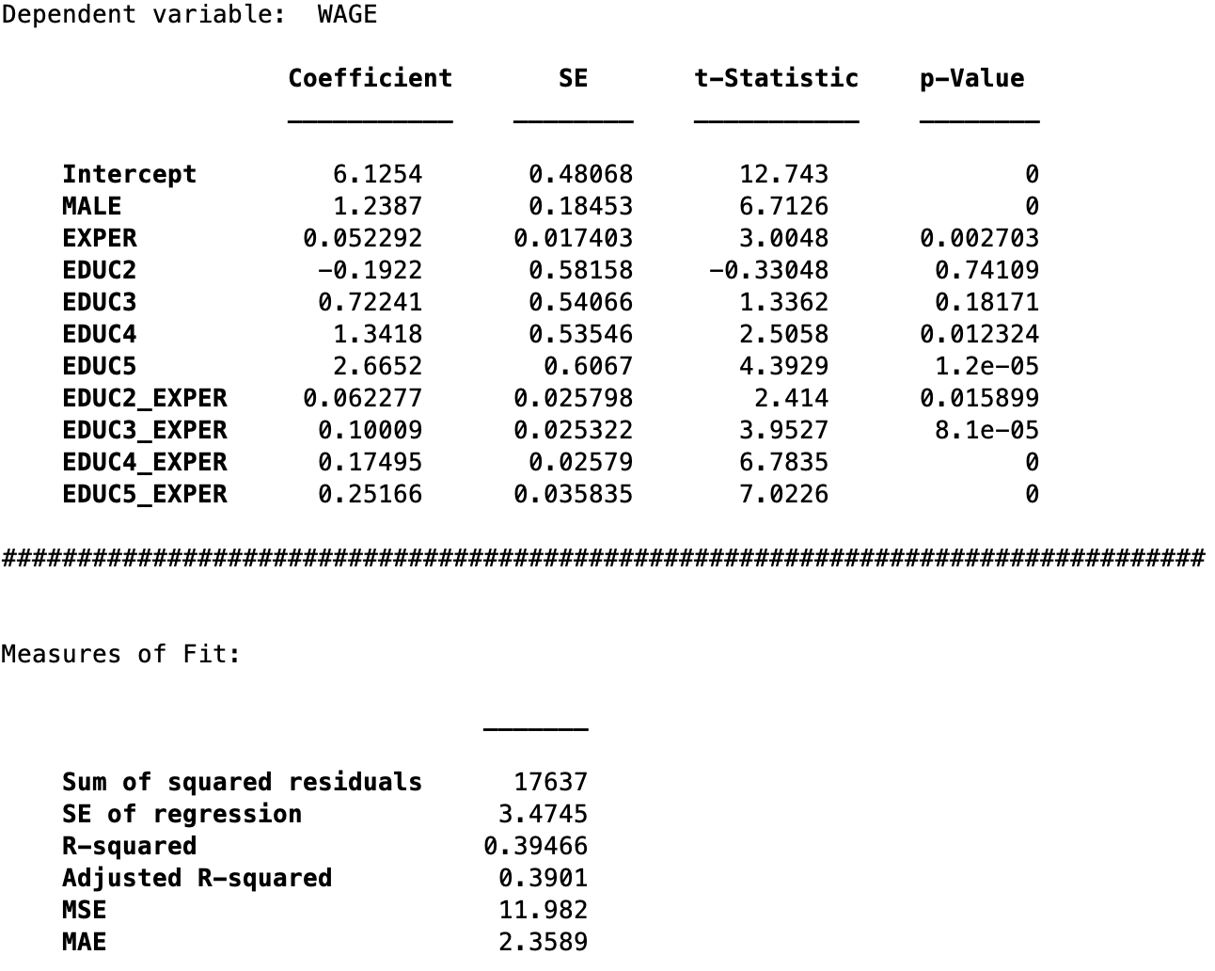
Regression 3: Dummy variable and OLS output
2. OLS output
1. Variable creation

